Slide 1
Predicting Severity of Car Accidents
Ali alfares
09-10-2020

Slide 2
Introduction
What are traffic collisions?
What is the problem studied in this report?
What is SEVERITY_CODE?
Who would be interested in a solution?
What could be potential projects based on this solution?
Traffic collisions or car accidents occur when a vehicle collides with other objects. Globally traffic collisions kill more than 1 million people annually and injure between 20-50 million. " SEVERITY_CODE" is usually used to categorize the rank-wise priority at high crash locations, it goes up with more injuries and/or fatalities. It's a best interest of governments, technology corporations and car manufacturers to be able to predict the severity of accidents. Potential projects such as A system that can assist drivers to take certain paths towards destination in order to reduce chances of accidents.

Slide 3
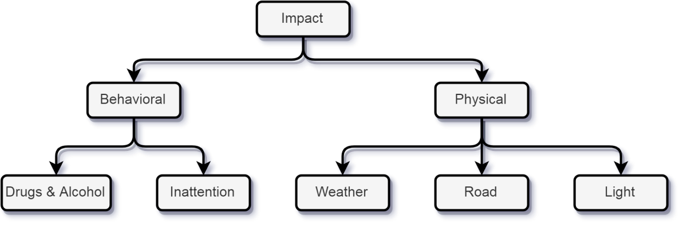
Data Acquisition & Cleaning
Source: Seattle state SPD & SDOT
Cleaning :
Group [focused]: (Physical) When “inattention” & “Drugs & alcohol” value is No
Group [not focused]: (Physical) When “inattention” & “Drugs & alcohol” value is yes

Slide 4
Classification
Classification models: K-Nearest Neighbor Decision Tree Support Vector Machine Random Forest Classifier Logistic Regression
106726 train records
26682 test records
3 categorical features with one-hot encoding = 23 binary features
"SEVERITYCODE" severity of the collision: • 3—fatality • 2b—serious injury • 2—injury • 1—prop damage • 0—unknown

Slide 5
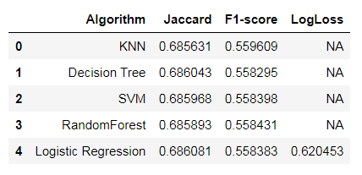
Accuracy Metrics
All models were very convergent with about 68.5% for Jaccard, 55.8% for F1-score.
Best Classifier

Slide 6
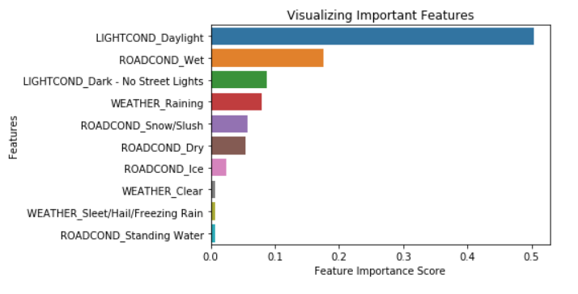
Feature Importance
Since the method ("feature_importances_") is not included in "Logistic Regression" model , we have to use it with the next model which is "Decision Tree" to calculate importance of features and visualize it using Seaborn.
When drivers drive during daylight they tend to increase their velocity and that's as a result exactly why it's more severe to drive in daylight and to have an accident.
As often as they are partly major causes of accidents, they may be considered to be causes of more severe accidents as well.

Slide 7
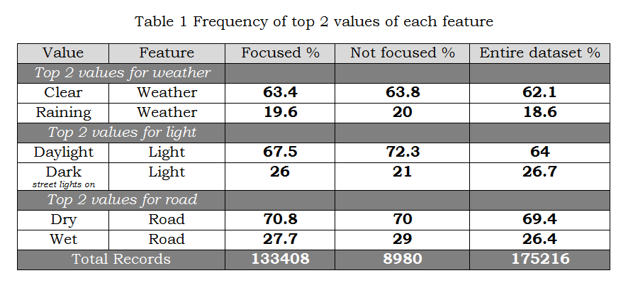
Human Behavior
we can see that the top 2 values of each feature is about 2-3 % different in frequency percentage overall between groups. By that we can conclude that being attentive or not is not correlated to specific physical circumstances. Thus it doesn't play a major role regarding severity of accidents.

Slide 8
Recommended New Data Features
Passenger count of vehicle(s) involved (the more.. higher the risk)
Location of vehicle (the more frequent a location in logs appears.. higher the risk)
Location of vehicle regarding street with high traffic at the same time of driving.
Type of transportation (higher code with bigger vehicles)

Slide 9
Conclusion
the best classifier was "Logistic Regression" which had 68.6% Jaccard accuracy metric.
It was trained and tested on 133408 records. We found that "Daylight" is a very important feature regarding severity of accidents because of drivers' tendency to increase velocity in daylight.
We recommended working harder on designing better data features which would help provide better accuracy in order to use it for model implementation in future projects.

